Slide 1
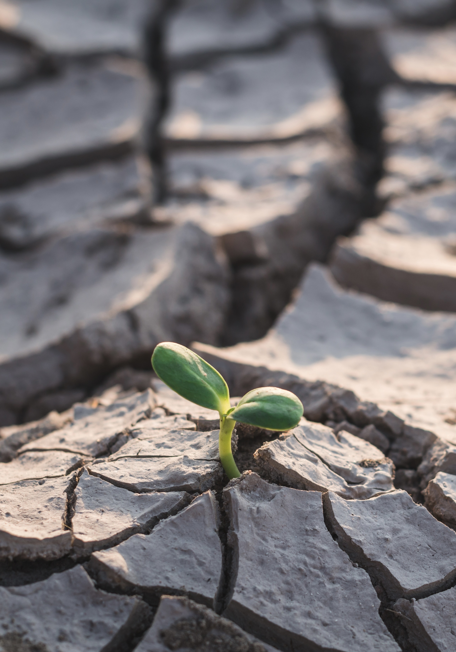





Title
WSU [insert county] Extension
Master Gardener Program

Slide 2



Climate
Change
Teaches ways to create resilient landscapes that are adapted to our changing climate.
Impact of climate change on people, wildlife and ecosystems
We all have a role to play
Techniques for home landscapes
Notes:
Warmer winters, hotter summers, flooding and droughts affect plant growth and impact the many organisms that interact with plants (insects, pollinators, diseases and microbes). Home gardeners have an important role to play in combating climate change. Choosing human-powered tools like push mowers, rakes and hand clippers over gas-powered tools such as lawn mowers and leaf blowers can reduce greenhouse gas emissions. Choosing resilient plants that are well adapted to your soil and climate and using research-based horticulture practices to manage soil will help keep your landscape resilient. Composting on-site closes the loop on waste and yields valuable nutrients and helps to reduce methane emissions from landfills.
This talk on [insert title] will give you a better understanding of the importance of creating resilient landscapes that can thrive in a changing climate, help you recognize that we all have a role to play in reducing the impact of climate change on our society and will provide you with specific techniques that you can use to build and maintain resilient landscapes in your own spaces.

Slide 3




Questions?
Insert Name
WSU Extension Master Gardener Volunteer
Contact info
http://mastergardener.wsu.edu/
https://www.facebook.com/WSUMGProgram

Slide 4

Optional Graphics
Mission
Engaging university-trained volunteers to empower and sustain diverse communities with relevant, unbiased, research-based horticulture and environmental stewardship education.

