Slide 1
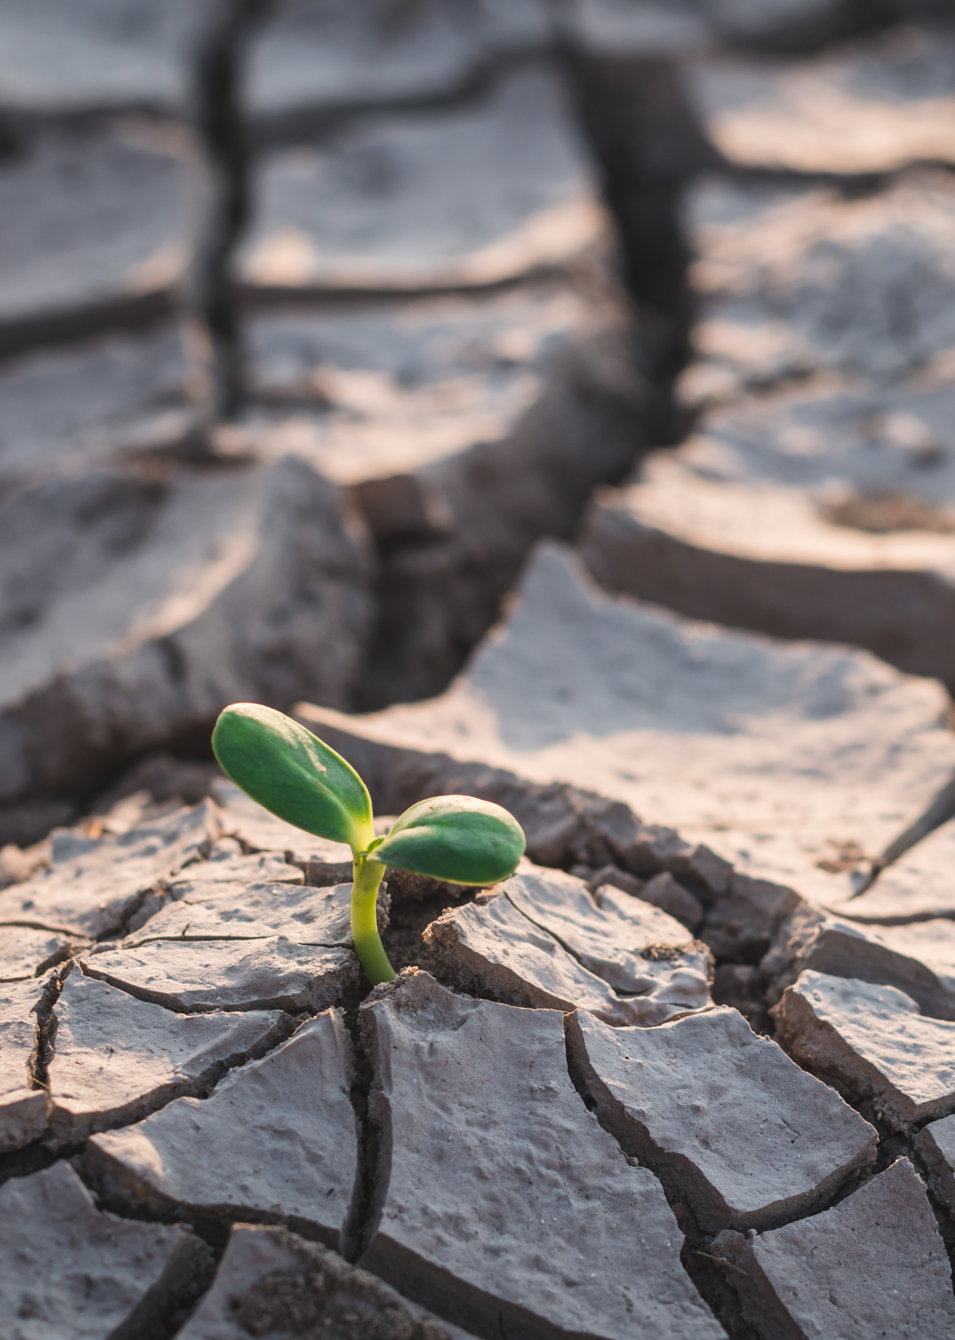





The Resilient Yard
Protect our Pollinators from the Effects of Climate Change
Angelina Lai and Karen Palmer
WSU Clark County Extension
Master Gardener Program

Slide 2

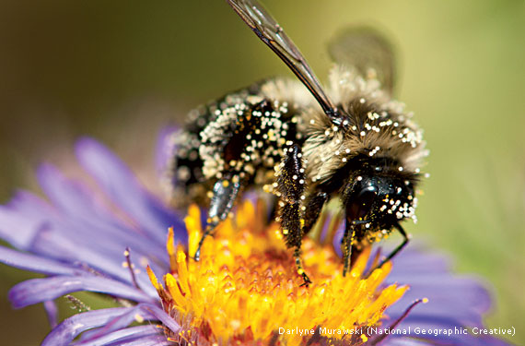

Goals
Climate Change Effects on Pollinators
Flower Anatomy
Pollination Biology
Types of Winged Pollinators
Providing Food and Forage for Pollinators
Protecting pollinators

Slide 3

Climate Change?
Greenhouse gasses trap the heat from the sun.
Carbon Dioxide (CO2) ~80%
Methane (CH4) ~12%
Nitrous Oxide (N2O) ~6%
Note:
Earth’s carbon doesn’t change,
Solid/liquid to gas is the issue
Notes:
Warmer winters, hotter summers, flooding and droughts affect plant growth and impact the many organisms that interact with plants (insects, pollinators, diseases and microbes). Home gardeners have an important role to play in combating climate change. Choosing human-powered tools like push mowers, rakes and hand clippers over gas-powered tools such as lawn mowers and leaf blowers can reduce greenhouse gas emissions. Choosing resilient plants that are well adapted to your soil and climate and using research-based horticulture practices to manage soil will help keep your landscape resilient. Composting on-site closes the loop on waste and yields valuable nutrients and helps to reduce methane emissions from landfills.
This talk on Pollinators will give you a better understanding of the importance of creating resilient landscapes that can thrive in a changing climate, help you recognize that we all have a role to play in reducing the impact of climate change on our society and will provide you with specific techniques that you can use to build and maintain resilient landscapes in your own spaces.

Slide 4
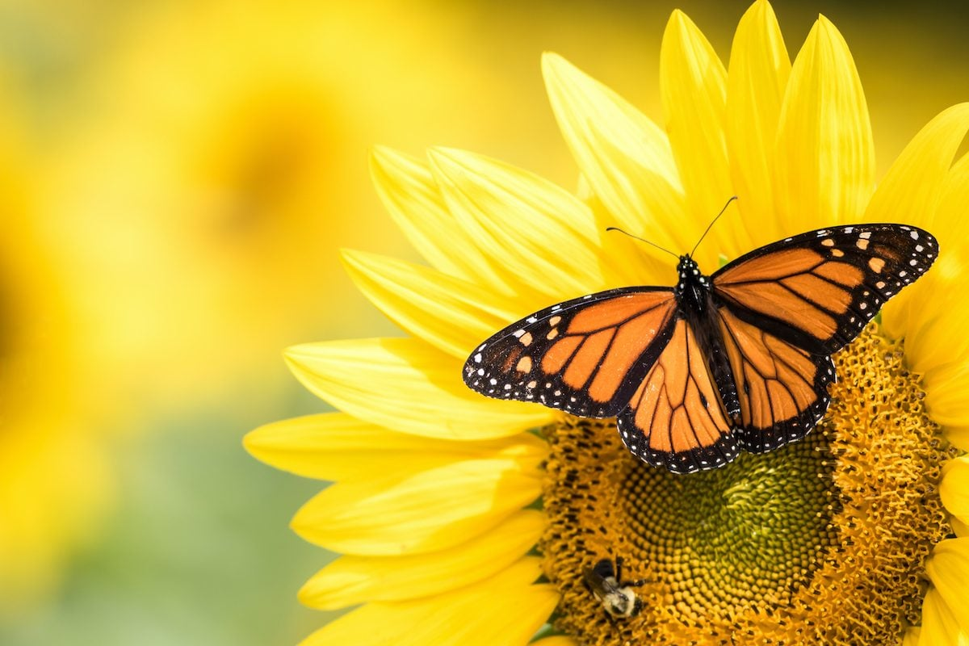
Climate Change Impact on Pollinators
Plants bloom sooner, limiting pollinator food
Drought causes less nectar, so pollinators get fewer calories
Extreme rainfall reduces flight time for pollinators
Source: www.climatehubs.USDA.gov

Slide 5
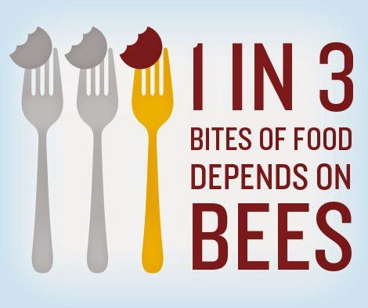
Why should we care?
They are just “bugs” after all!
  Most plants reproduce by flowers. Per USDA, 1 out of every 3 bites of food we consume depends on the work of pollinators.
So, if you want to eat, you SHOULD care!
USDA: www.usda.gov/peoples-garden/pollinators

Slide 6
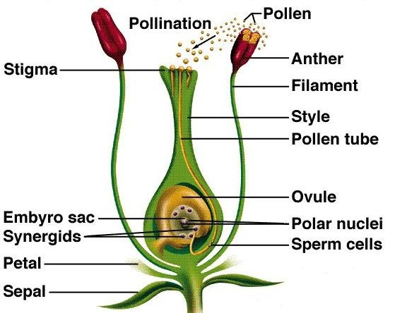
Flower Anatomy
Sepals protect the flower bud and attract pollinators
Pistil is the female part; consists of stigma, style, ovule
Stamen is the male part; consists of anther, filament
Pollen sticks in stigma; provides food for pollinators and produces new seedling
University of Florida: gardeningsolutions.ifas.ufl.edu

Slide 7
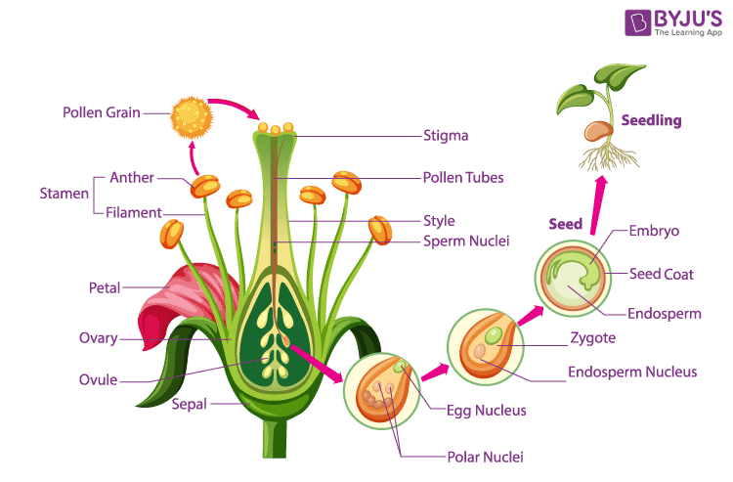

Slide 8

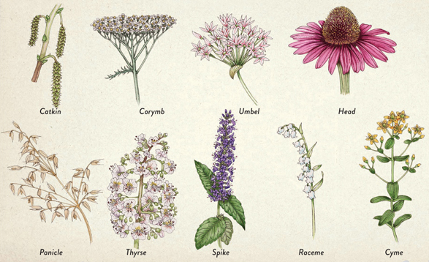
Flower Structures
Different structures attract different pollinators
Aim for a variety of flower structures in your landscape

Slide 9
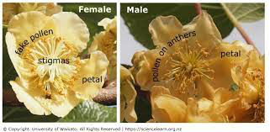
Fertilization
Remember: we need to eat so we need the plants to be fertilized
Fertilization occurs with the transfer of pollen from male to female sex organs
Who does that? That’s right, our pollinators!
Dioecious plants need a male plant and a female plant. Kiwi is one example. Other examples are spinach and asparagus.
University of Waikato: www.sciencelearn.org.nz/images/63-kiwifruit-flowers

Slide 10
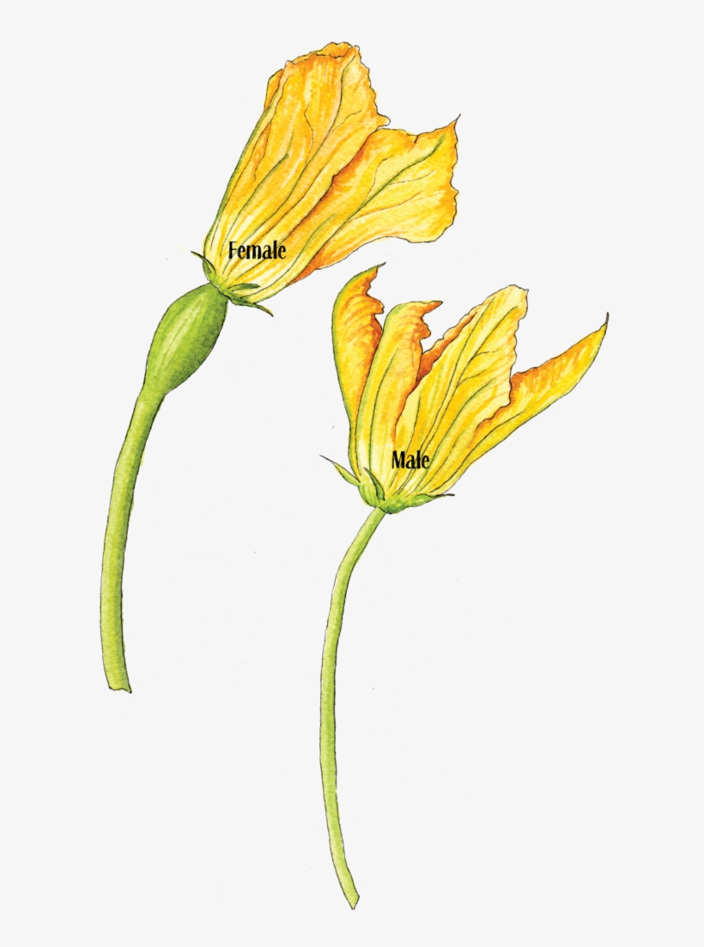
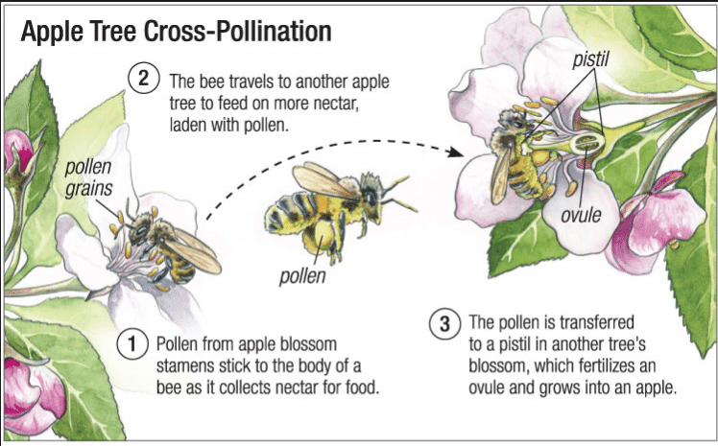
Fertilization
Many food producing plants are Monoecious
The same plant produces both male and female flowers
Other examples: corn, fig, melons, apples, nuts
Cucumber
Arbor Day Foundation: www.arborday.org

Slide 11
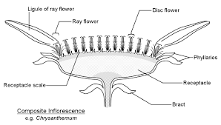
Fertilization
Many flowers are Composite plants
Contain many smaller florets
Examples: yarrow, coreopsis, dahlia, zinnia, goldenrod, fleabane, aster, cosmos, Black-eyed Susan, and lettuce
Ideal landing pads for bees
Sunflower

Slide 12
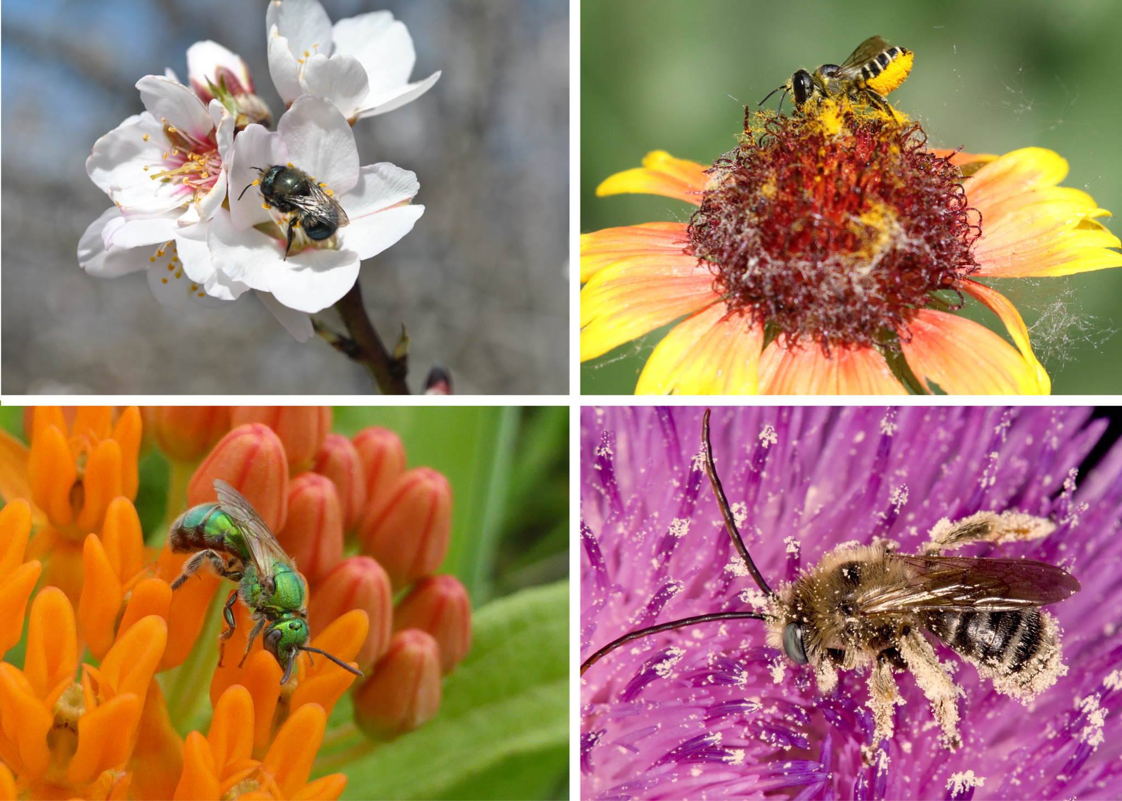
Bees = Pollination
Without bees, we don’t eat
Without bees, our yards would be dreary

Slide 13
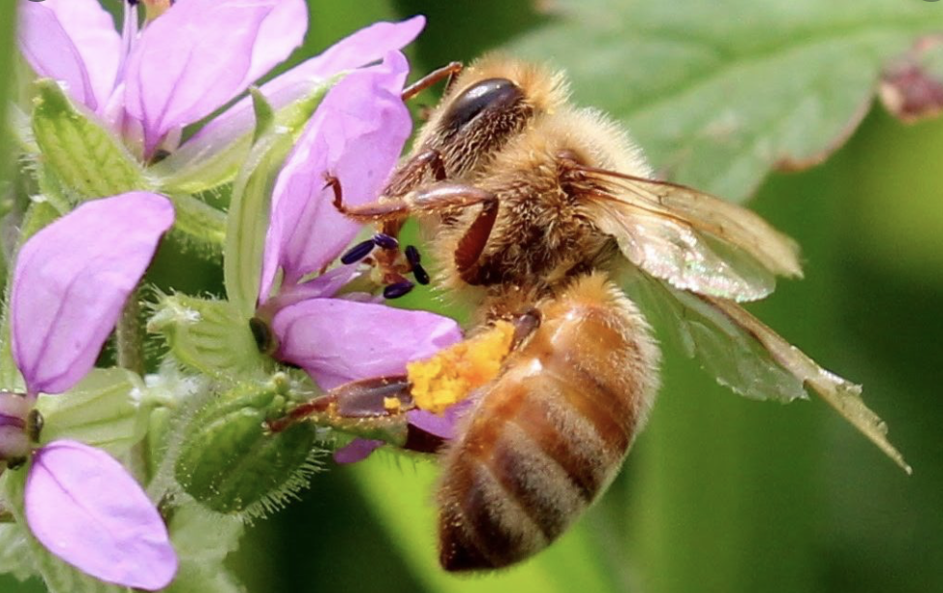
Honey Bee
Colonies live year-round
Generalist foragers
Colors seen: ultra-violet patches on flowers: blue, purple, white
A few of their favorite flowers: Russian sage, zinnia, oregano, borage, lavender, rhododendron

Slide 14
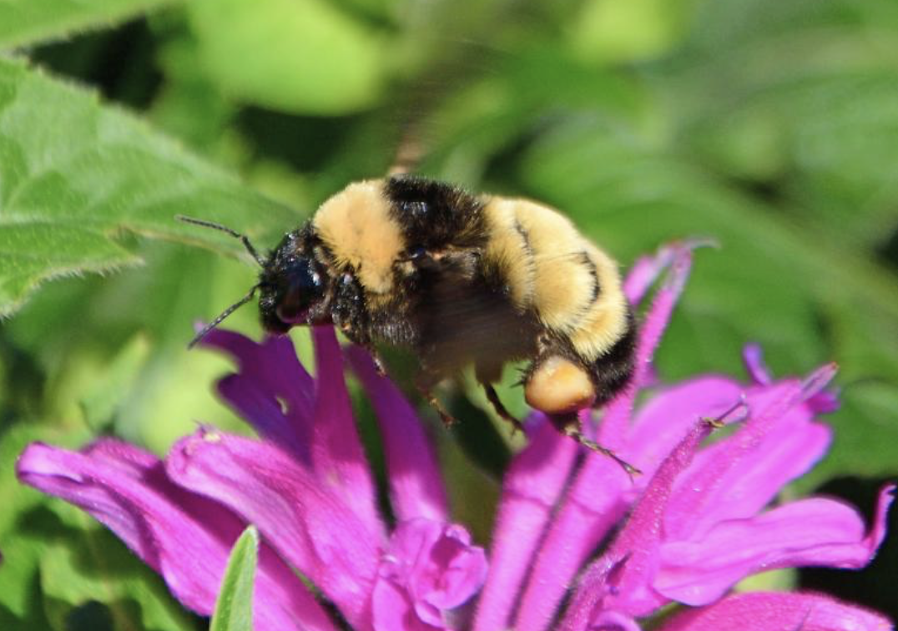
Bumble Bee
Generalist foragers
Food crops: tomatoes, watermelon, blueberries
Practice buzz pollination (cause vibrations to release pollen)
A few of their favorite flowers: Lavender, blue blossom, sunflower, columbine, salvia, blueberry

Slide 15
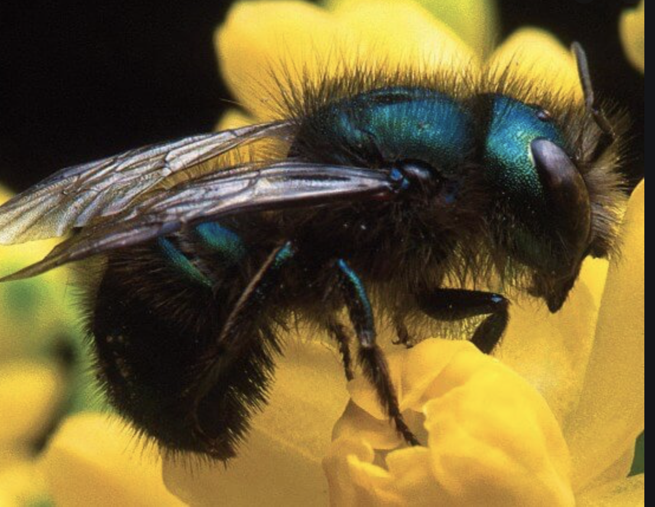
Orchard Mason Bee
Short active foraging time when fruit trees bloom
Travel only about 200 feet
Require water and mud
Food crops: fruit trees
A few of their favorite flowers: Oregon grape, apples, plums, pears, peaches, cherry, rose, salvia, thyme

Slide 16
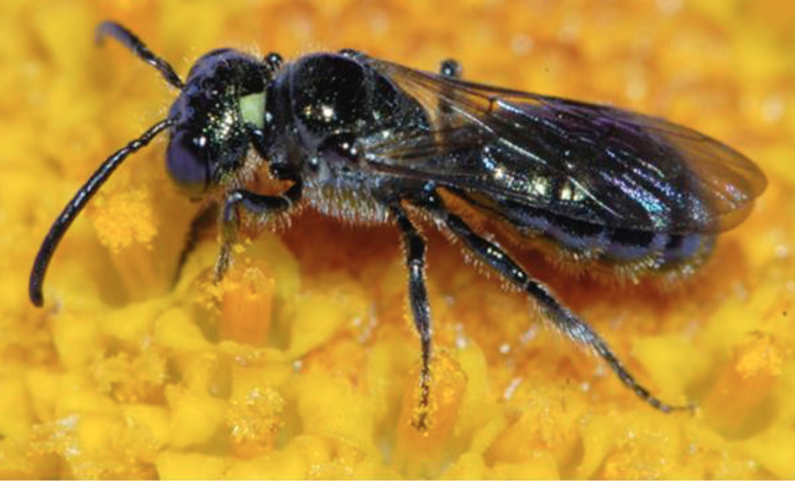
Small Carpenter Bee
Generalist forager
Nests in pithy vertical stems
Found in woodlands, gardens, meadows, prairies
A few of their favorite flowers: Morning glory, salvia, sorrel, sunflowers, caneberries

Slide 17
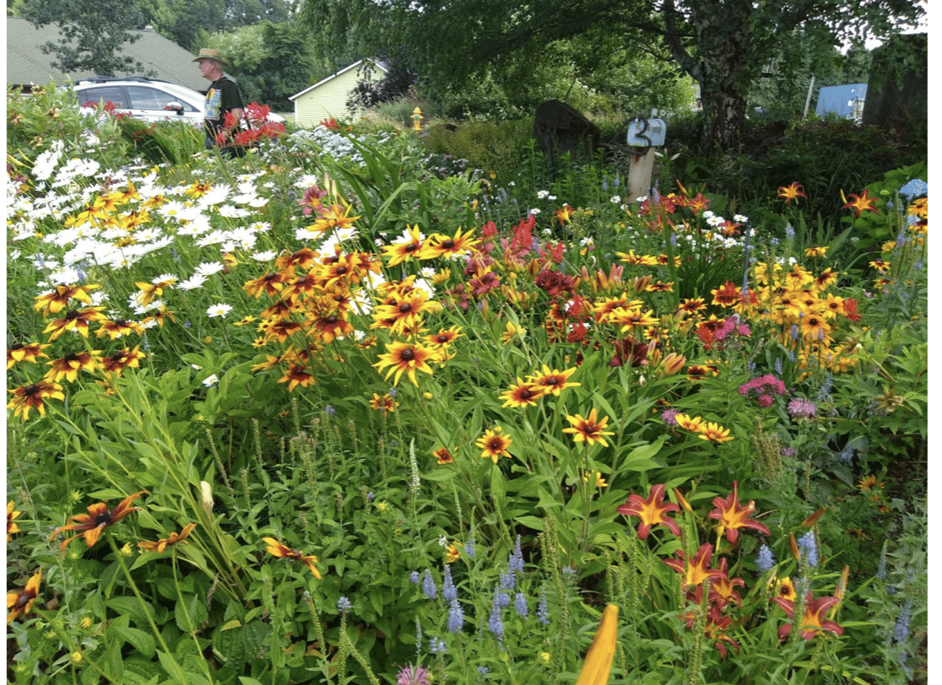
Bee “Vision”
Bees see colors
Bees see ultra-violet color
Bees see motion
Bees see brokenness
BUT…

Slide 18
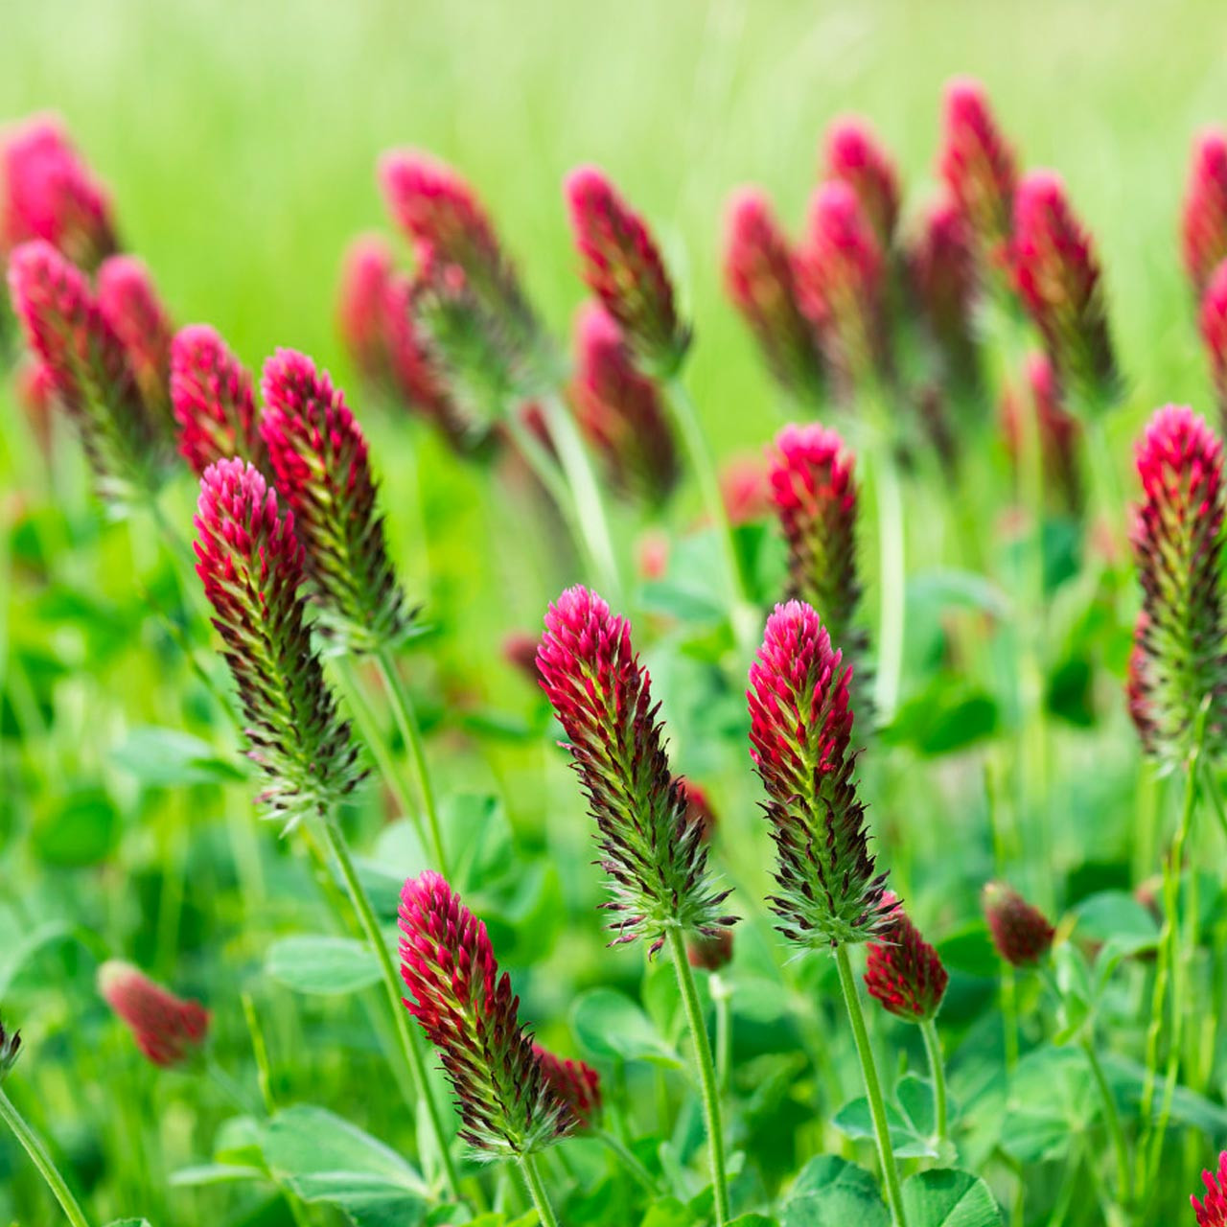
Bees don’t see red!
Yellow portion of catalpa tree flower will change color to red only after the flower is pollinated
Crimson clover has white center to be visible to bees
Isn’t nature amazing?

Slide 19
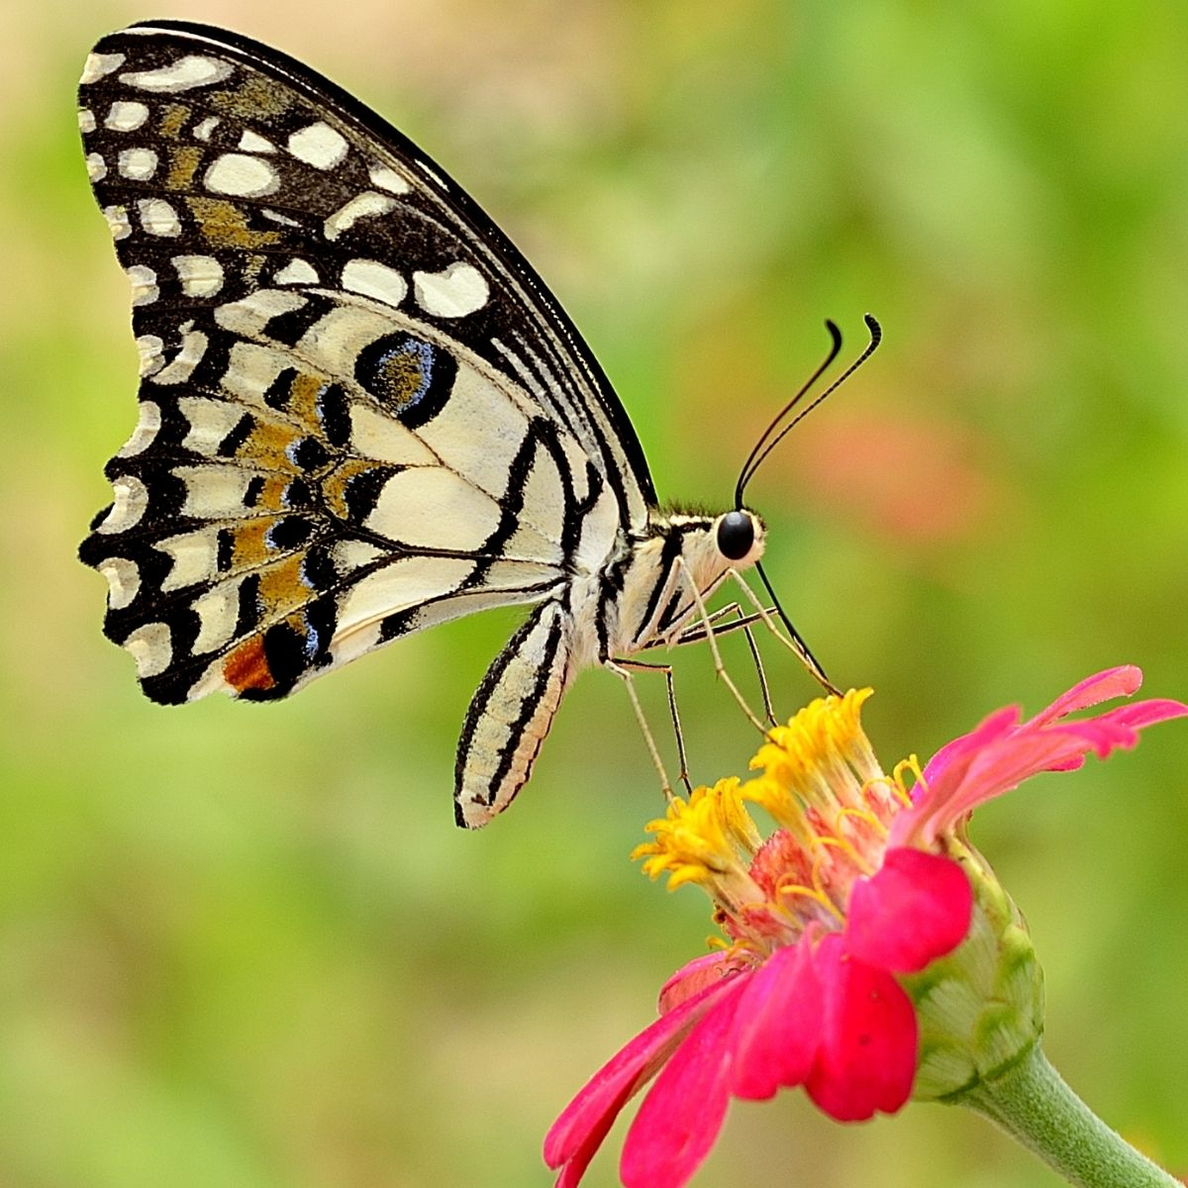
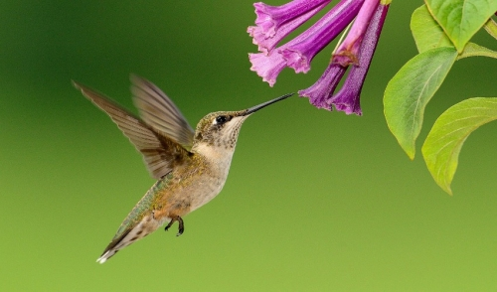
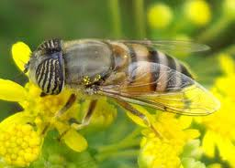
It’s Not Just Bees
Butterflies and moths are eye-catching and they also pollinate flowers
Beetles pollinate Magnolia, sweetshrub and paw paws
Flies pollinate members of the carrot family
Hummingbirds pollinate bright tubular flowers (and they see red!)
Syrphid Fly

Slide 20
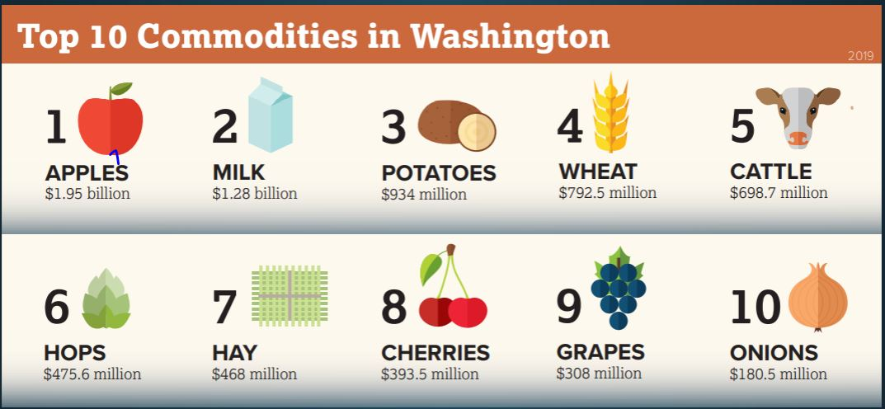
Washington State Major Food Crops
Crops that depend on pollinators: Apples, Cherries, Grapes, Corn, Onions
Okay, we could still grow potatoes, wheat, and hay…
Beer (hops) is good but…
70% of all other produce needs pollination – the brewery may not care but the community SHOULD*
*McFleshman’s Brewing Company

Slide 21
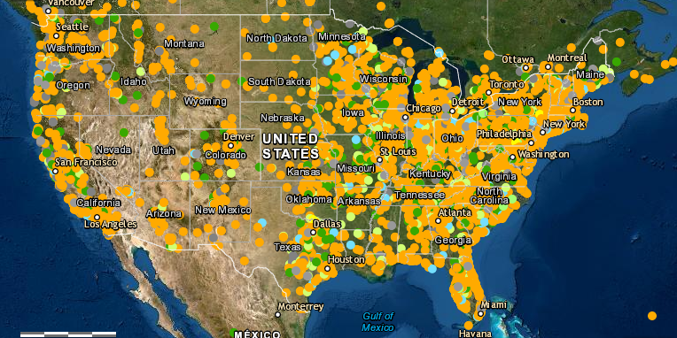
What Can A Homeowner Do?
Avoid pesticides (eliminate the use of neonicotinoids)
Plant more pollinator-friendly flowers
Provide nesting sites
Spread the word
Current locations pledged to protect pollinators
Resource: Xerces Society, www.xerces.org
Notes:
Neonicotinoids kill indiscriminately bees, butterflies, other wildlife

Slide 22

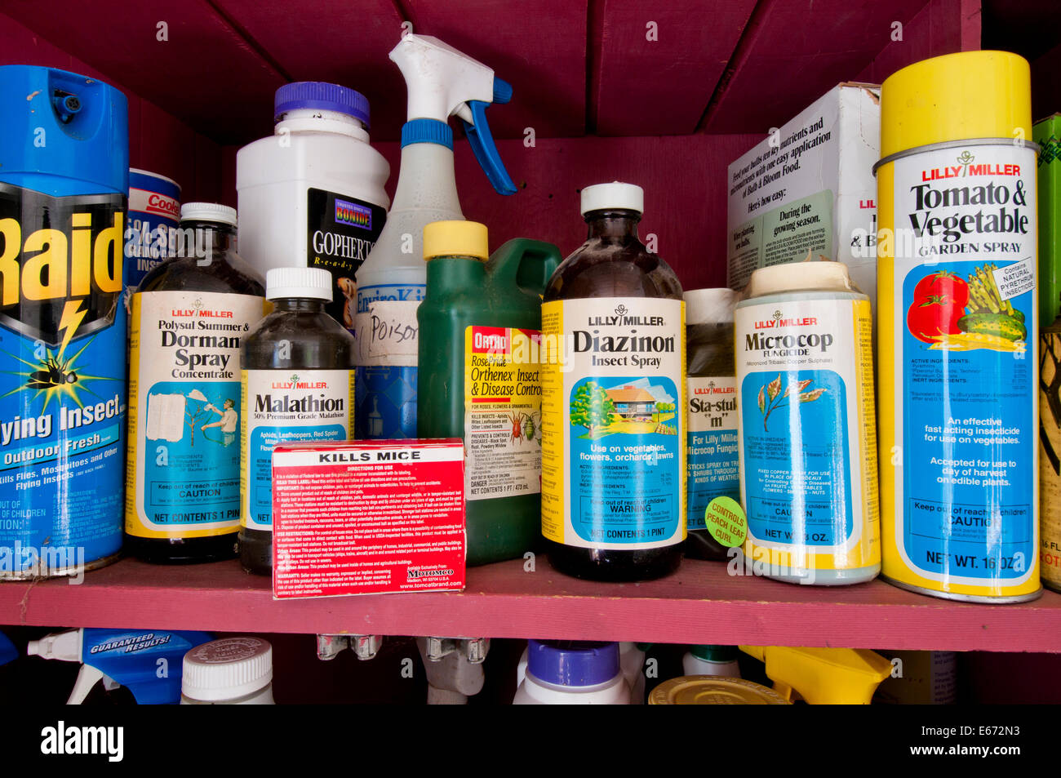
Avoid Pesticides
Insecticides are harmful to pollinators
Herbicides reduce food sources
Fungicides can have synergistic effects on bees
Search for ecological pest management strategies
Always follow label directions, even when using organic products
Notes:
Neonicotinoids kill indiscriminately bees, butterflies, other wildlife

Slide 23
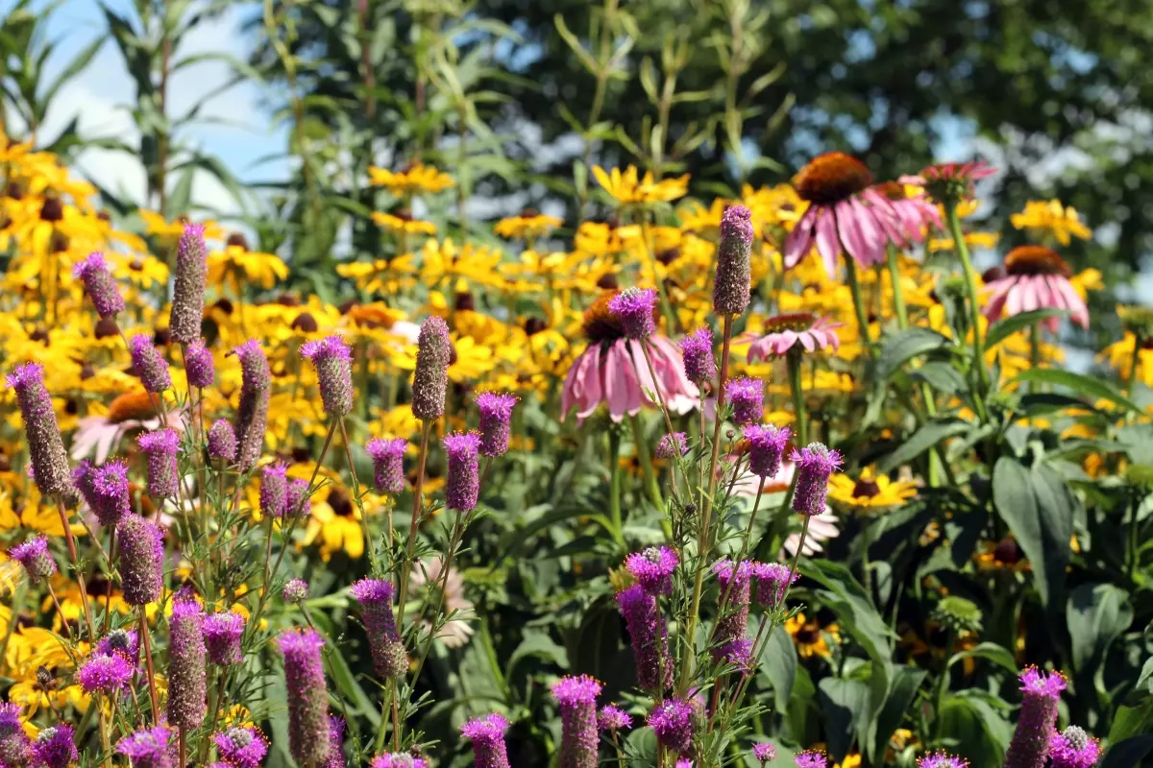
Plant a Pollinator Garden
Flowers provide nectar and pollen (think food) for pollinators
Provide different flower structures that appeal to a wide range of pollinators
Support pollinators spring through fall by providing plants with different bloom times
Pollinator Partnership: www.nwcb.wa.gov/pdfs/PacificLowlandrx8.pdf
U.S. Fish and Wildlife Service: www.fws.gov

Slide 24
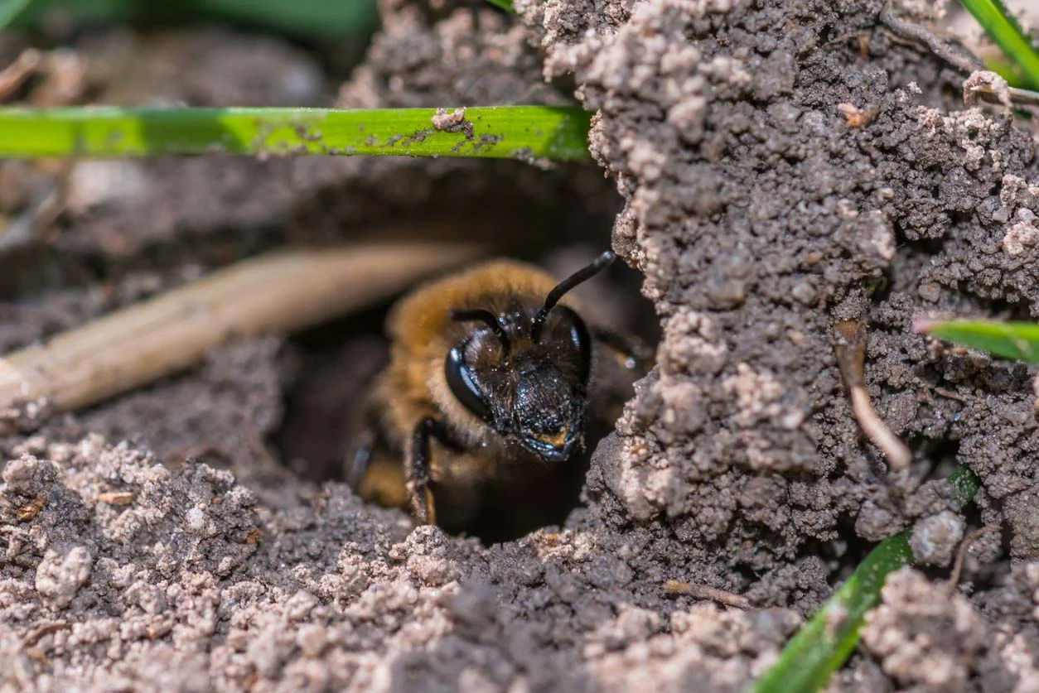
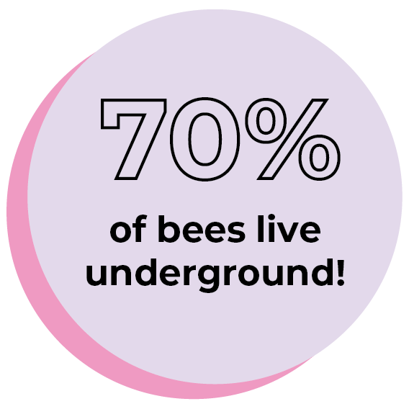
Provide nesting sites
All stages of pollinator life cycle need support, including eggs and larvae
Leave patches of bare ground and brush piles
Leave a little mess in the yard for overwintering ground bees and insects
Plant caterpillar host plants
The Bee Conservancy: thebeeconservancy.org

Slide 25
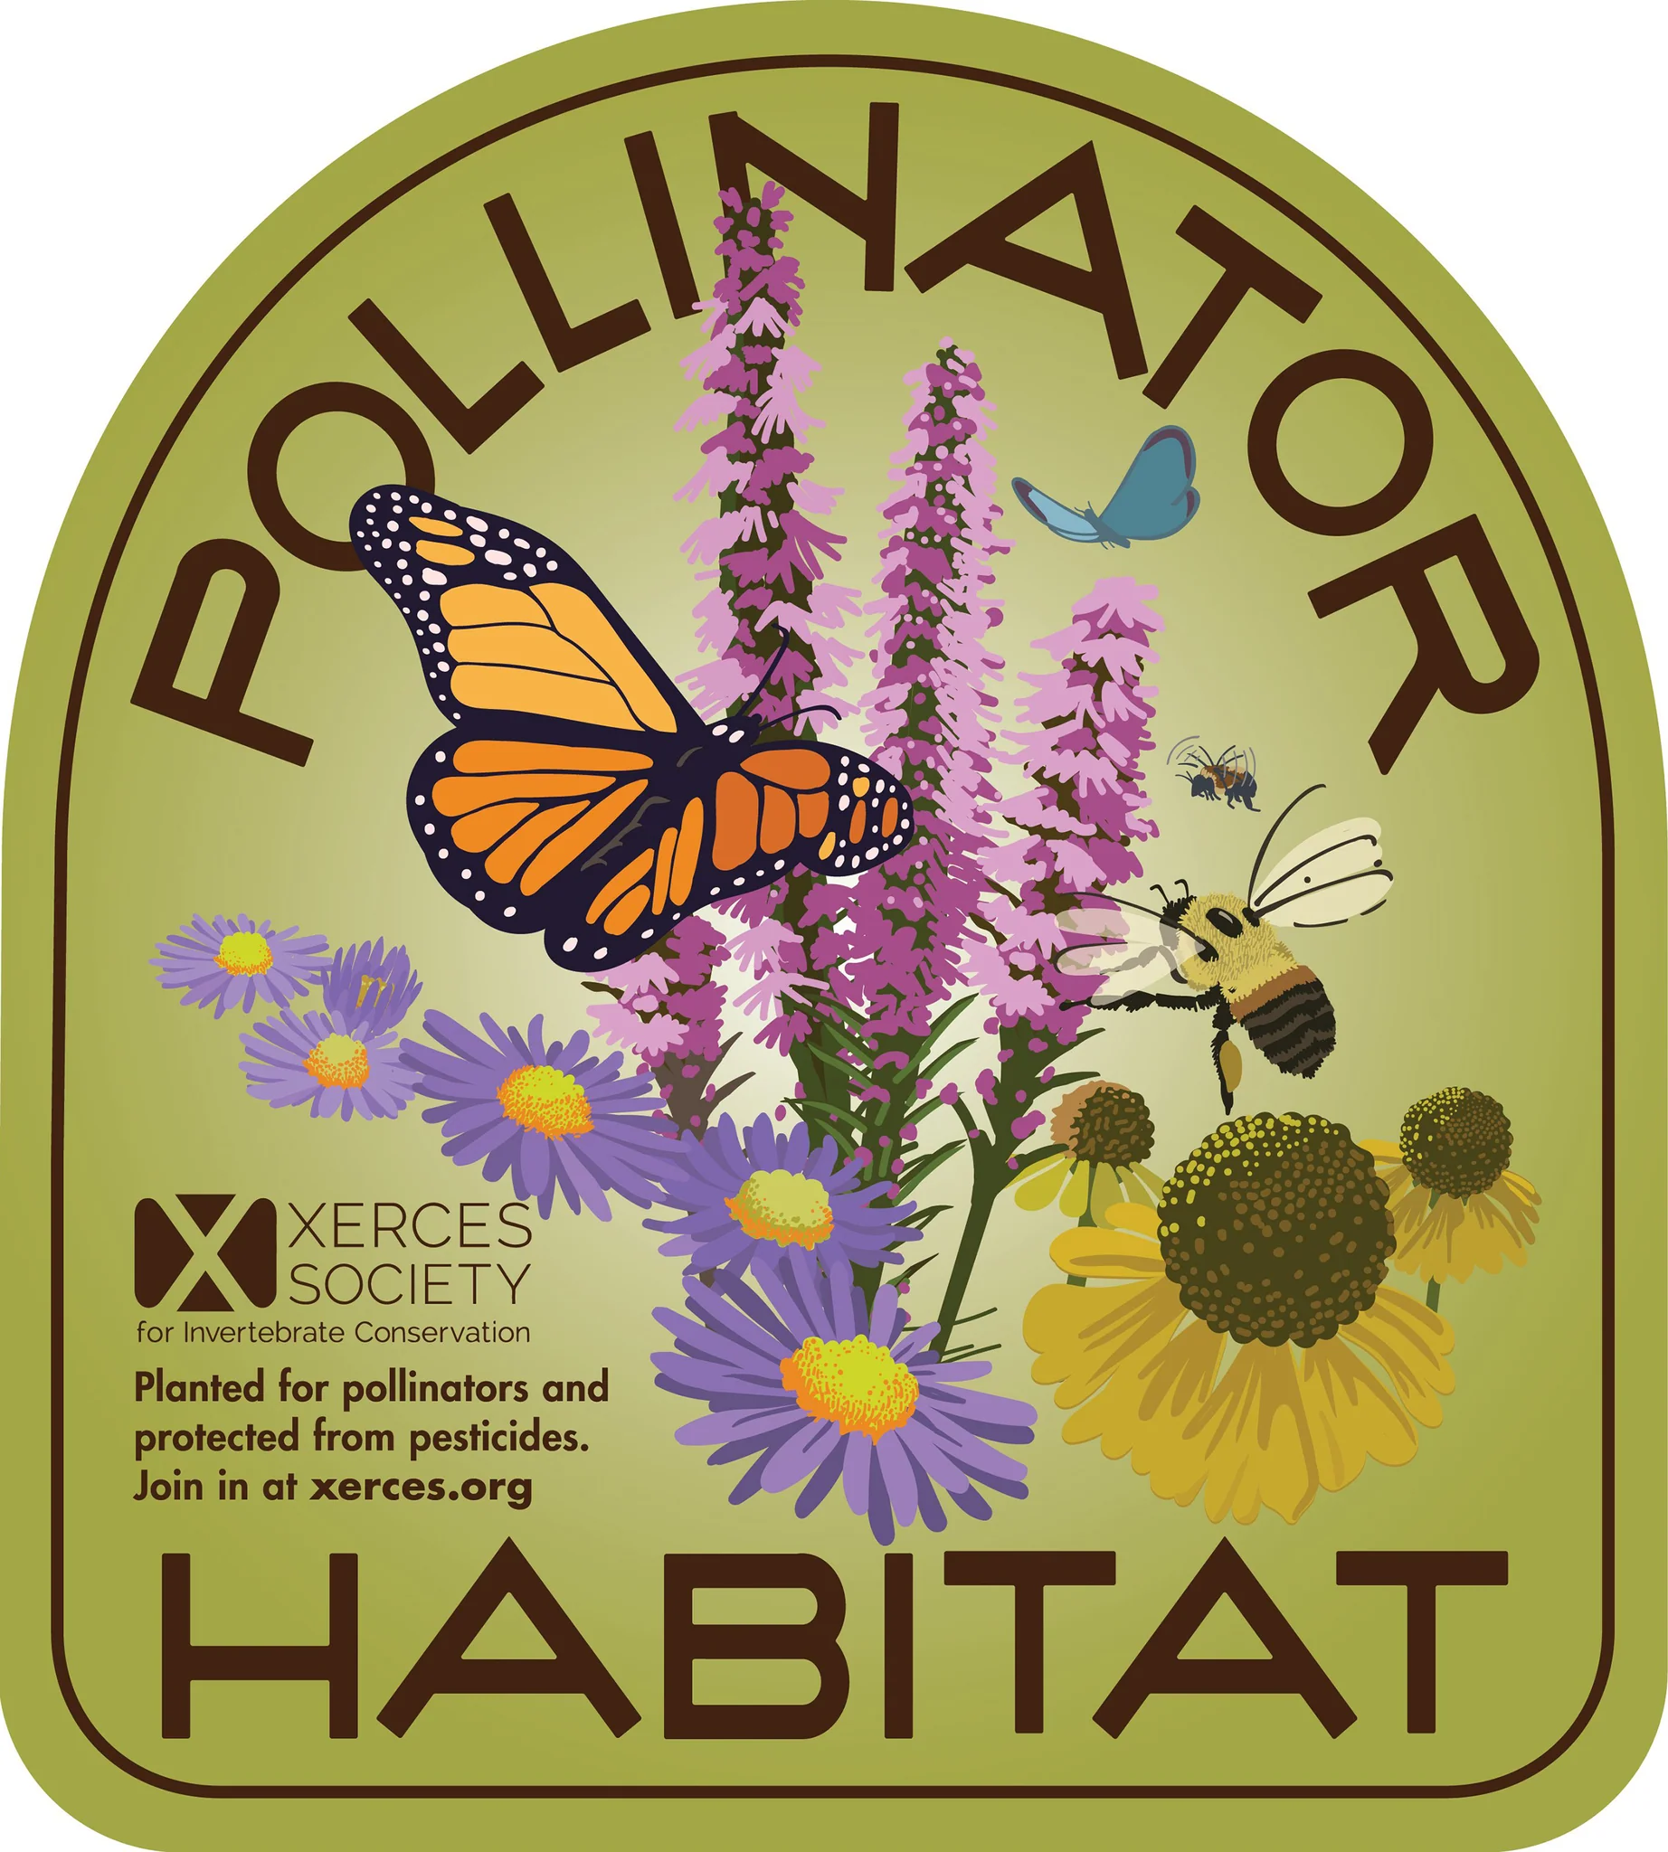
Spread the Word
Share information via social media
Invite your neighbors to “do the right thing”
Get a pollinator habitat sign from Xerces Society and post it proudly

Slide 26
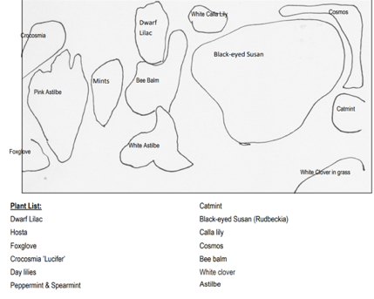
Planning a Pollinator Garden
Starting from scratch or adding to existing bed?
Sun? Shade?
Even natives need a little water to get started

Slide 27
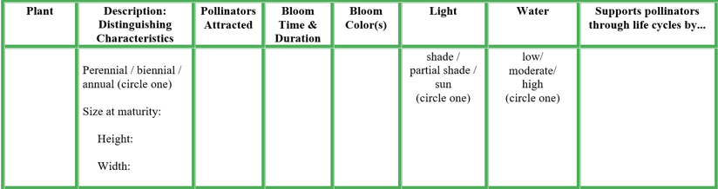
Start with a Chart

Slide 28
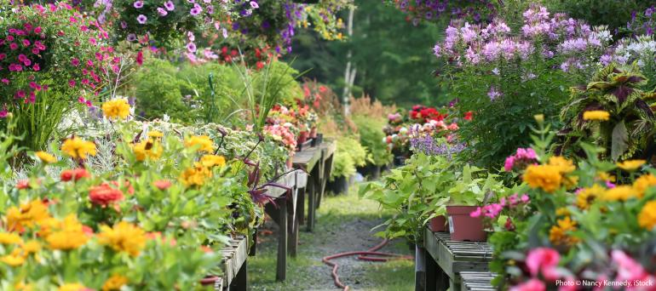
Shop for Plants
Keep in mind…
Sun exposure
Pollinator-friendly plants
Natives
Water and soil preference
Bloom time
From Borage to Zinnia, there are dozens of options
Visit www.xerces.org/publications/plant-lists for options in your growing environment

Slide 29
Planting for Honey Bees
Go native
Plant in clusters and clumps
Use blues, purples, whites
Umbra shaped and daisy shaped flowers for landing
Plant to attract and support the bees throughout the whole season
- Spring: Oregon grape, elderberry, snowberry, yarrow
- Summer: California poppies, iris, lupine, oregano
- Fall: Goldenrod, Joe Pye weed, purple asters, pineapple
sage, black-eyed Susan
- Winter: Hellebores, crocus, loquat

Slide 30
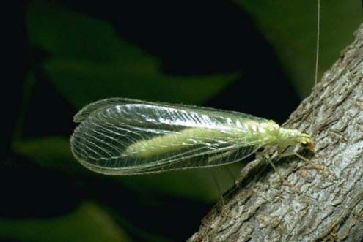
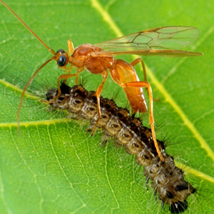
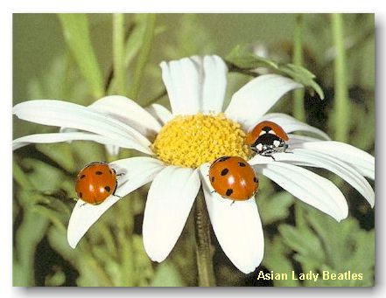
Beneficials
All these tactics will also aid beneficial insects
Lady beetles, lacewings, parasitic wasps, etc. control many pest insects naturally
Pollinate your food and take care of aphids with four easy steps!

Slide 31

Four Easy Steps
Reduce use of pesticides (less work for you)
Plant pollinator-friendly flowers (enjoy the beauty)
Provide nesting sites (let some leaves stay on the ground – less work for you)
Toot your own horn (we all love to brag)
Do more of this!

Slide 32



Questions?
Insert Name
WSU Extension Master Gardener Volunteer
Contact info
http://mastergardener.wsu.edu/
https://www.facebook.com/WSUMGProgram

Slide 33

Notes:
WSU Extension is the front door to the University. It extends non-credit education to people throughout the state.
WSU Extension empowers people, organizations, businesses, and communities to find solutions for local issues.
WSU Extension is recognized for its science-based educational programs and collaboration with community partners to create a culture of life-long learning.
Such programs include 4H, Agriculture, Community and Economic Development, Youth and Families, Nutrition, Gardening and natural resources.

Slide 34
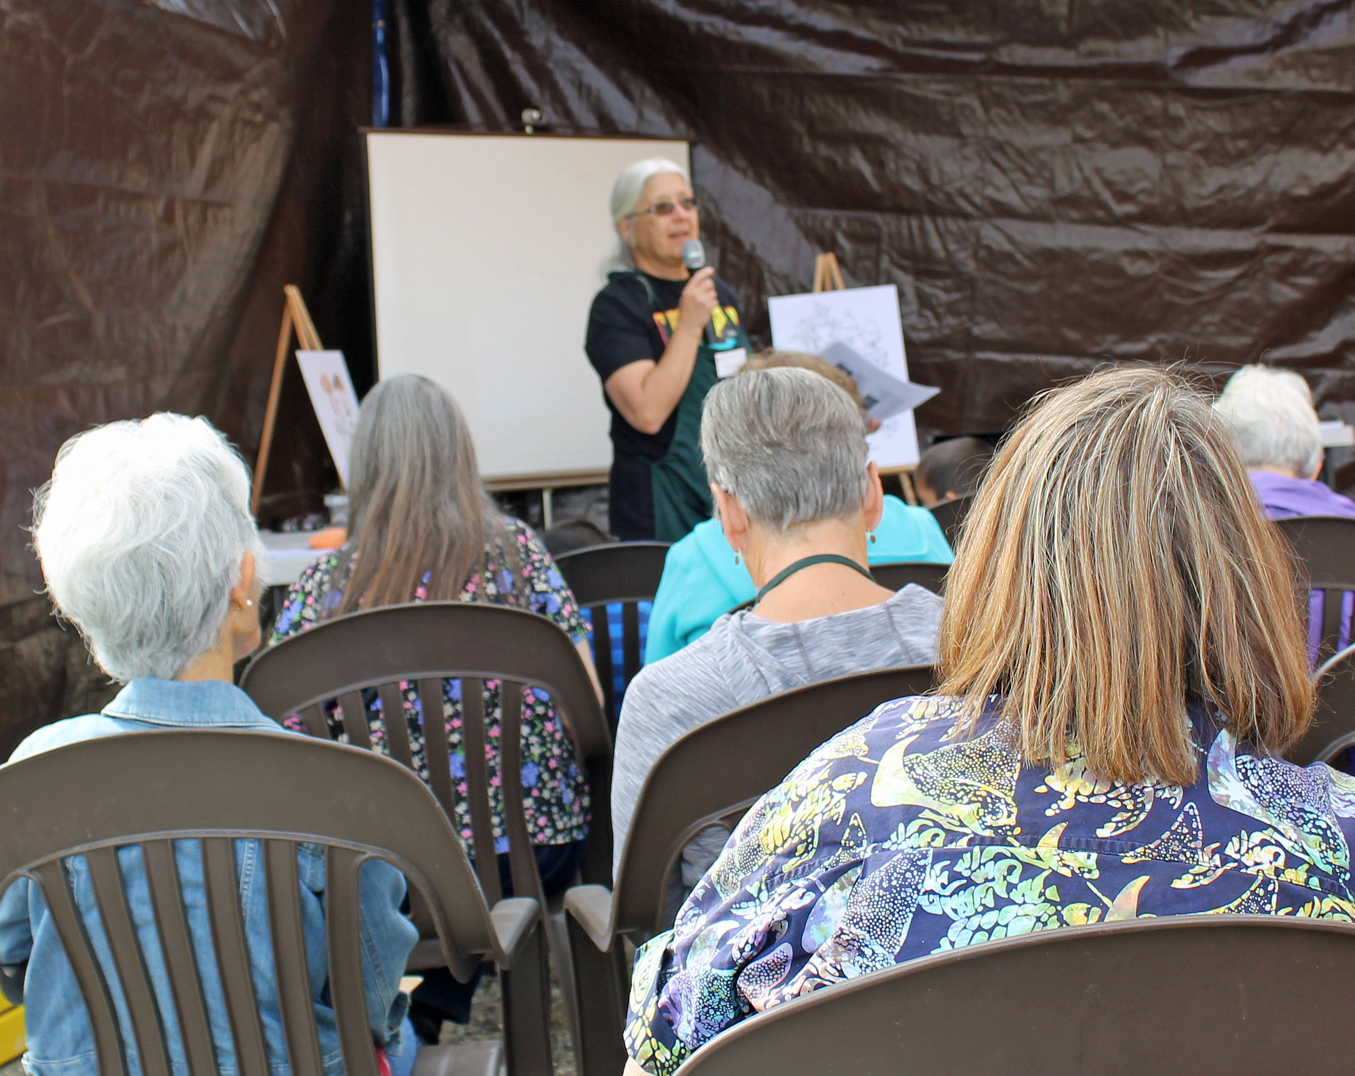
Mission
Engaging university-trained volunteers to empower and sustain diverse communities with relevant, unbiased, research-based horticulture and environmental stewardship education.

